Slide 1
CSE 219: Digital Logic & Computer Design
Tamanna Haque Nipa
Assistant Professor
Dept. of CSE
Stamford University Bangladesh

Slide 2
Decoders
A decoder is a digital circuit that detects the presence of a specified combination of bits (code) on its inputs and indicates the presence of that code by a specified output level.
In its general form, a decoder has n input lines to handle n bits and from one to 2^{n} output lines to indicate the presence of one or more n-bit combinations.
2 to 4 Line
Decoder
D₀
D₁
D₂
D₃
A
B

Slide 3


2 to 4 Line Decoder
A | B
0 | 0
0 | 1
1 | 0
1 | 1
D0 | D1 | D2 | D3
2 to 4 Line
Decoder
D₀
D₁
D₂
D₃
1 | 0 | 0 | 0
A
B
0 | 1 | 0 | 0
0 | 0 | 1 | 0
0 | 0 | 0 | 1
A
B
Equations:
D₀
D₀ = A⁰B⁰
D₁ = A⁰B
D₁
D₂ = AB⁰
D₃ = AB
D₂
D₃

Slide 4
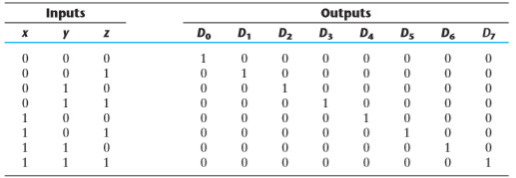
3 to 8 Line Decoder
D₀ = x⁰y⁰z⁰
D₄ = xy⁰z⁰
D₁ = x⁰y⁰z
D₅ = xy⁰z
D₂ = x⁰yz⁰
D₆ = xyz⁰
D₃ = x⁰yz
D₇ = xyz

Slide 5
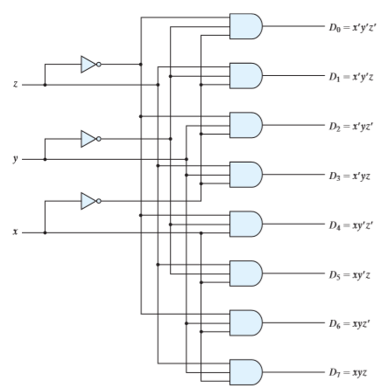
3 to 8 Line Decoder
D₀ = x⁰y⁰z⁰
D₁ = x⁰y⁰z
D₂ = x⁰yz⁰
D₃ = x⁰yz
D₄ = xy⁰z⁰
D₅ = xy⁰z
D₆ = xyz⁰
D₇ = xyz

Slide 6
4 to 16 Line Decoder
2 to 4 line decoder ---- 2 inputs and 2² =4 outputs
3 to 8 line decoder ---- 3 inputs and 2³ =8 outputs
4 to 16 line decoder ---- 4 inputs and 2⁴ =16 outputs
5 to ? line decoder ---- 5 inputs and ? Outputs
Read yourself: Applications of Decoder

Slide 7
3x8 line decoder constructed with 2x4 line decoders
2x4 line decoder : inputs : 2, output : 4
3x8 line decoder : inputs : 3, output : 8
2 to 4 Line
Decoder
D₀
D₁
D₂
D₃
A
0
0
0
0
B | C
0 | 0
0 | 1
1 | 0
1 | 1
Enables if A=0
B
C
E
A
0 | 0
0 | 1
1 | 0
1 | 1
1
1
1
1
2 to 4 Line
Decoder
D₄
D₅
D₆
D₇
Enables if A=1
E

Slide 8
3x8 line decoder constructed with 2x4 line decoders
2x4 line decoder : inputs : 2, output : 4
3x8 line decoder : inputs : 3, output : 8
2 to 4 Line
Decoder
D₀
D₁
D₂
D₃
B
C
Enables if A=0
E⁰
A
2 to 4 Line
Decoder
D₄
D₅
D₆
D₇
Enables if A=1
E⁰

Slide 9
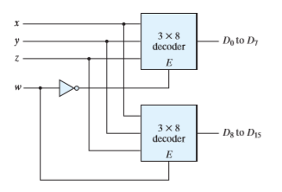
4x16 line decoder constructed with 3x8 line decoders

Slide 10

Implementation of function using Decoder
F(X,Y,Z) = Σ (2,4,6,7)
3 to 8 Line Decoder
D₀
D₁
D₂
D₃
X
Y
Z
F
D₄
D₅
D₆
D₇

Slide 11

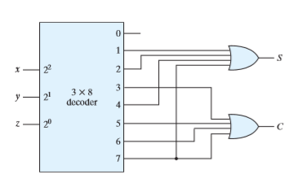
Implementation of Adder using Decoder
Any Expression can be implemented by decoder
(practice: d(p,q,r,s)= Σ (0, 3, 5, 6, 7, 9, 12) )

Slide 12
Encoder
An encoder is a digital circuit that performs the inverse operation of a decoder.
An encoder has 2^{n} input lines and n output lines.
The output lines, as an aggregate, generate the binary code corresponding to the input value.
D₀
D₁
D₂
D₃
4 to 2 line Encoder
A
B

Slide 13
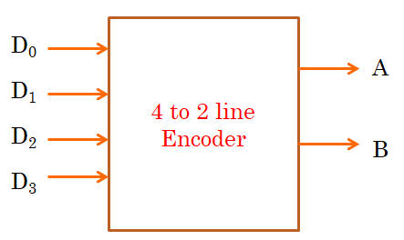
4 to 2 line Encoder
D0 | D1 | D2 | D3
1 | 0 | 0 | 0
0 | 1 | 0 | 0
0 | 0 | 1 | 0
0 | 0 | 0 | 1
A | B
0 | 0
0 | 1
1 | 0
1 | 1
D₁ D₂ D₃
A= D2+D3
B=D1+D3
A
B

Slide 14
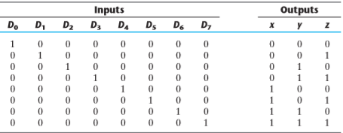

8 to 3 line Encoder

Slide 15
8 to 3 line Encoder
D₁ D₂ D₃ D₄ D₅ D₆ D₇
x
y
z

Slide 16
Encoder
4 to 2 line encoder ---- 4 inputs and 2² = 4, 2 outputs
8 to 3 line encoder ---- 8 inputs and 2³ =8, 3 outputs
16 to ? line encoder --16 inputs and 2⁴ =16, ? outputs
32 to ? line encoder ----32 inputs and ? Outputs
Read yourself: Applications of Encoder
Priority Encoder: A priority encoder is an encoder circuit that includes the priority function. The operation of the priority encoder is such that if two or more inputs are equal to 1 at the same time, the input having the highest priority will take precedence.

Slide 17
Multiplexer
A multiplexer is a combinational circuit that selects binary information from one of many input lines and directs it to a single output line.
The selection of a particular input line is controlled by a set of selection lines.
Normally, there are 2^{n} input lines and n selection lines whose bit combinations determine which input is selected.
I₀
I₁
I₀
I₁
I₂
I₃
2 to 1 line MUX
4 to 1 line MUX
Y
Y
S₀
S₁
S₀

Slide 18
4 to 1 Line Multiplexer
S1 | S0 | Y
0 | 0 | I0
0 | 1 | I1
1 | 0 | I2
1 | 1 | I3
Y= S1⁰S0⁰I0 + S1⁰S0I1 + S1S0⁰ I2+ S1S0I3
S1
S0
I0
I1
Y
I₀
I₁
I₂
I₃
Y
4 to 1 line MUX
I2
S₁
S₀
I3

Slide 19
Multiplexer
Implement 2 to 1 line MUX
Implement 8 to 1 line MUX
Applications of MUX
Read yourself

Slide 20
4x1 line MUX constructed with 2x1 line MUX
2x1 line MUX : inputs : 2, selector : 1
4x1 line MUX : inputs : 4, selector : 2
I₀
I₁
2 to 1 line MUX
E
S₁
Y
I₂
I₃
2 to 1 line MUX
E
S₀

Slide 21
Boolean Function Implementation
F(A,B,C,D) = Σ (2,4,6,7,10,11,14,15) … use 16x1 line MUX
1
0
16 x 1 line
MUX
0
1
2
3
4
5
6
7
8
9
10
11
12
13
14
15
F
A
B
C
D

Slide 22
Boolean Function Implementation
F(A,B,C,D) = Σ (2,4,6,7,10,11,14,15) using 8x1 line MUX
16x1 line MUX : inputs : 16, selector : 4
8x1 line MUX : inputs : 8, selector : 3
 | I0 | I1 | I2 | I3 | I4 | I5 | I6 | I7
A⁰ | 0 | 1 | 2 | 3 | 4 | 5 | 6 | 7
A | 8 | 9 | 10 | 11 | 12 | 13 | 14 | 15
Equations:
A0 :
A :
GND :
VCC :
I4
I3
I0, I1, I5
I2, I6, I7

Slide 23
Boolean Function Implementation
F(A,B,C,D) = Σ (2,4,6,7,10,11,14,15) using 8x1 line MUX
Equations:
A
0
1
8 x 1 line
MUX
0
1
2
3
4
5
6
7
A⁰ :
A :
GND :
VCC :
I4
I3
F
I0, I1, I5
I2, I6, I7
B C D
Implement F(x,y,z)= Σ(0,1,4,6) using a 8x1 line MUX
Implement F(x,y,z)= Σ(0,1,4,6) using a 4x1 line MUX

Slide 24
Implement F(x,y,z)= Σ(0,1,4,6) using a 8x1 line MUX
VCC
GND
8 x 1 line
MUX
0
1
2
3
4
5
6
7
X Y Z

Slide 25
Implement F(x,y,z)= Σ(0,1,4,6) using a 4x1 line MUX
 | I0 | I1 | I2 | I3
X⁰ | 0 | 1 | 2 | 3
X | 4 | 5 | 6 | 7
X
0
1
4 x 1 line
MUX
Equations:
0
1
2
3
X⁰ :
X :
GND :
VCC :
I1
F
I2
I3
I0
Y Z

Slide 26
DeMultiplexers (DeMUX)
A DeMultiplexer is a combinational circuit that directs the single input line to selected one of many output lines.
The selection of a particular output line is controlled by a set of selection lines.
Normally, there are 2^{n} output lines and n selection lines whose bit combinations determine which output is selected.
O₀
O₁
O₂
O₃
1 to 4 Line
DeMUX
Y
S1 S0

Slide 27
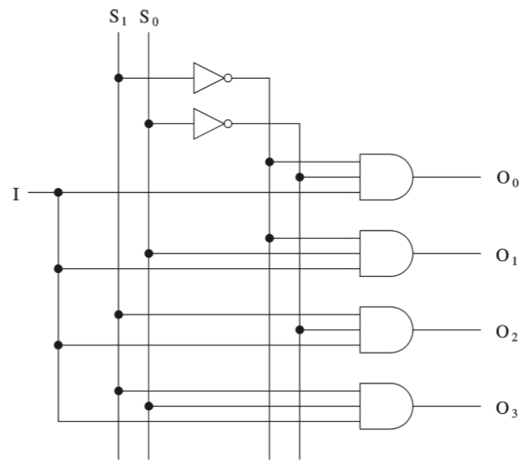
1x4 line DeMultiplexers
I | S1 | S0 | Output
1 | 0 | 0 | O0
1 | 0 | 1 | O1
1 | 1 | 0 | O2
1 | 1 | 1 | O3
0 | X | X | 0
O0 = IS1⁰S0⁰
O1 = IS1⁰S0
O2 = IS1S0⁰
O3 = IS1S0

